Slide 1
Markov Transition Model For Classic Rock Music
Eddie, Heywood, Chase, Finn, and Harrison
Goal: Generate new chord sequences and songs
Notes:
Finn

Slide 2
PROJECT OVERVIEW & Goal
Our Music Generator models chord progressions using Markov Chains to replicate the style of a particular Spotify artist of genre.
The probability of the ‘next’ chord (state) relies on the previous x-chords (states).
Project Goal:
Build a model that creates chord progressions replicating those of famous artists.
Identify the most realistic levels of sequential dependence and the pros and cons of each.

Slide 3
Data: Collection & Cleaning
Data Source: Chordonomicon file containing ~670k songs and chord progressions.
Cleaning:
Removed tags from chord data, and converted strings of chords into Python lists.
Converted all chords into format that music21 (Python library) can read to produce music interface.
Cleaned the columns pertaining to artist names and genres for easier sub-setting of the data.
Notes:
Finn

Slide 4
State space and Sequential dependence
State Space: Our state space is defined as the unique set of musical chords for a particular genre or artist.
For example, there are 355 unique chords across 502 classic rocks songs.
Sequential Dependence (Order): The order of our chain determines how many preceding chords are used to predict the ‘next’ chord.
In our modeling, we tested 1st , 2nd , and 3rd order chains to find the most realistic musical patterns.
Transition Matrix: Shows the relative probability of moving from one state to another.
Our matrix is large but sparse. There is a long tail of rare chords and changes that happen infrequently.
Notes:
State Space and Sequential Dependence
State Space:
Defined as the unique set of chords for a given artist or genre.
Each chord represents a state, and transitions capture how one chord leads to another.
Sequential Dependence (Order):
The order (k) of the Markov Chain determines how many previous chords influence the next one.
We tested first-, second-, and third-order dependencies to find the most realistic musical behavior.
1st-Order Dependence:
Next chord depends only on the current chord.
Often drifts between keys — creates an avant-garde or less stable tonality.
2nd-Order Dependence:
Next chord depends on the previous two chords.
Provides enough context to stabilize to a major or relative minor key.
Works well for pop/rock, but less so for jazz, which modulates more frequently.
3rd-Order Dependence:
Next chord depends on the previous three chords.
Adds strong tonal stability but risks overfitting to existing progressions.
Produces realistic but less novel music — especially for repetitive genres.
Transition Matrix:
Captures the probability of moving from one chord (state) to another.
Derived empirically from real chord sequences per artist or genre.

Slide 5
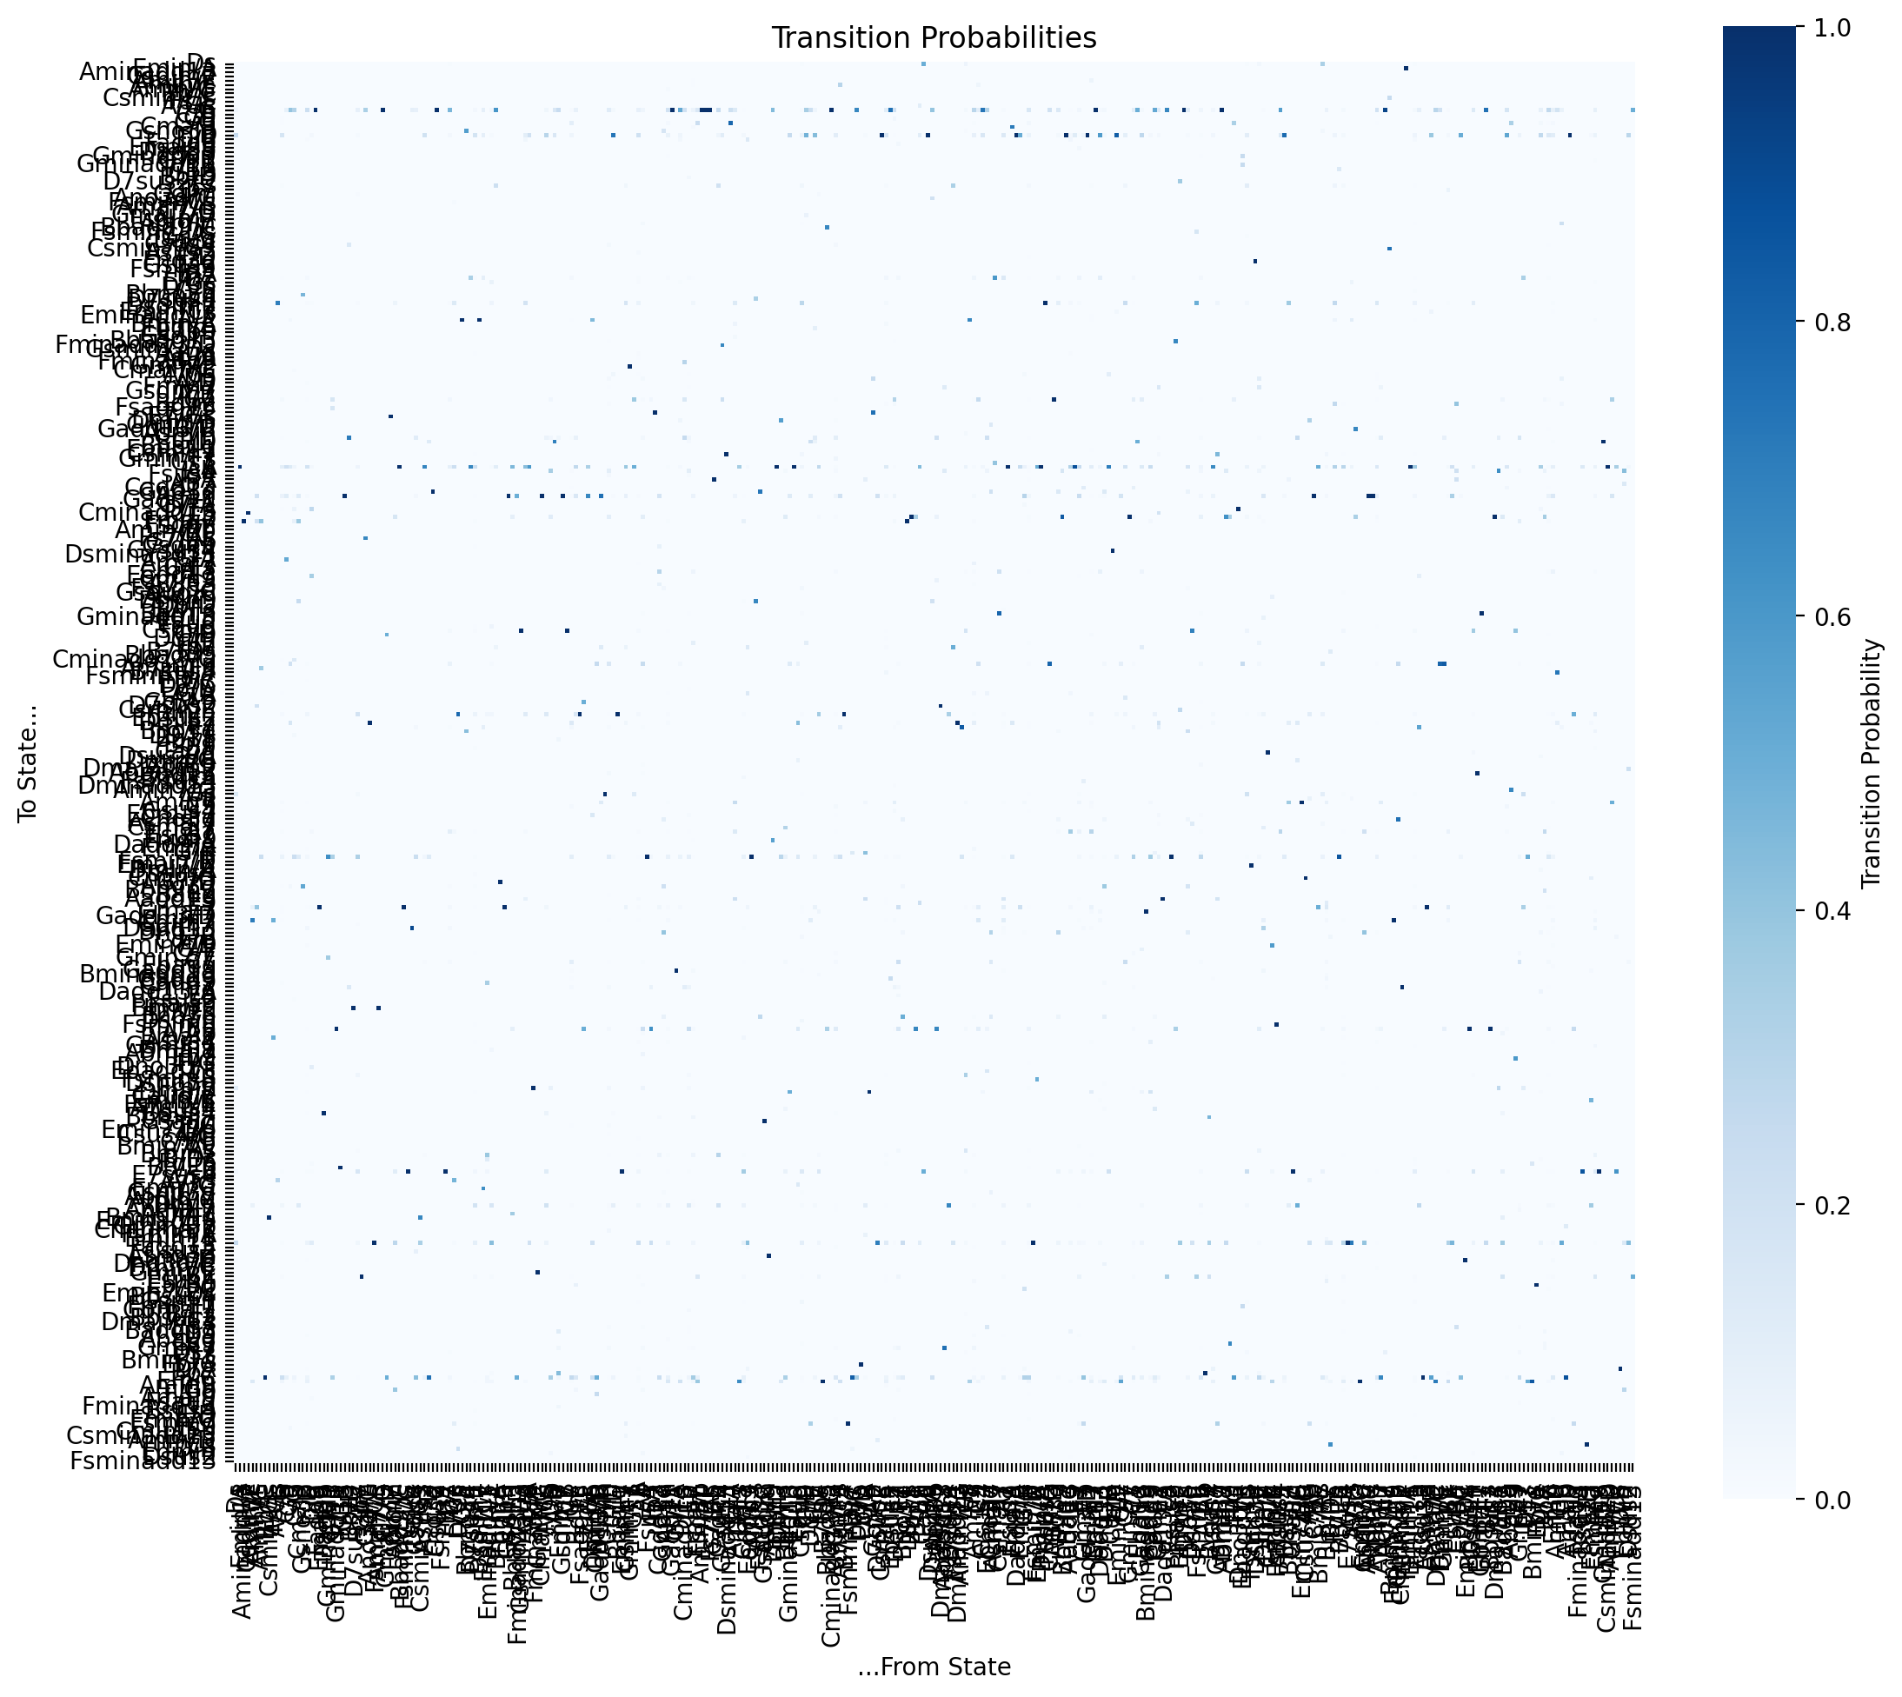
Transition MatriX
Notes:
Eddie

Slide 6
Our MODEL…
Jupyter Notebook code walkthrough.

Slide 7
Takeaways
Markov Chains capture local chord changes to probabilistically generate a longer sequence/song. This has its limitations...
Sequential Dependance: Hard to strike balance between structure and novelty.
1st Order: Frequently drifts to different keys; less stable tone.
2nd Order: Tends to stabilize within 2 musical keys. (except for jazz…)
3rd Order: Stable within a given key but does not create anything particularly novel.
Notes:
Harrison
1st-Order Dependence:
Next chord depends only on the current chord.
Often drifts between keys — creates an avant-garde or less stable tonality.
2nd-Order Dependence:
Next chord depends on the previous two chords.
Provides enough context to stabilize to a major or relative minor key.
Works well for pop/rock, but less so for jazz, which modulates more frequently.
3rd-Order Dependence:
Next chord depends on the previous three chords.
Adds strong tonal stability but risks overfitting to existing progressions.
Produces realistic but less novel music — especially for repetitive genres.

Slide 8
Limitations & Future Work
Generating an entire song with only local dependance means that short harmonic patterns are captured but the song lacks long range consistency and structure.
Order: Hard to find a level of sequential dependance that strikes a balance between creating something ‘new’, while preserving tasteful musical qualities.
1st Order lacks important musical structure while 3rd order is ‘overfits’ to known chord progressions.
2nd Order generally works well, but keys still modulate randomly.
Harmony Only: No rhythm/melody/voice-leading modeling to add musical color.
Future Considerations:
Higher-order chains, HMMs, or neural sequence models
Integrate rhythm patterns and melodic contours; add constraints
Notes:
1st-Order Dependence:
Next chord depends only on the current chord.
Often drifts between keys — creates an avant-garde or less stable tonality.
2nd-Order Dependence:
Next chord depends on the previous two chords.
Provides enough context to stabilize to a major or relative minor key.
Works well for pop/rock, but less so for jazz, which modulates more frequently.
3rd-Order Dependence:
Next chord depends on the previous three chords.
Adds strong tonal stability but risks overfitting to existing progressions.
Produces realistic but less novel music — especially for repetitive genres.

